Slide 1
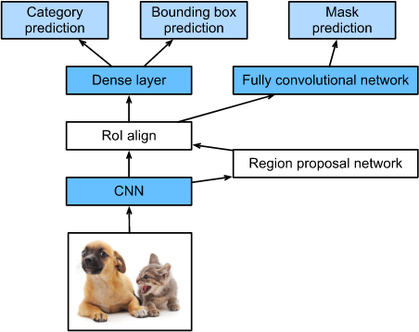
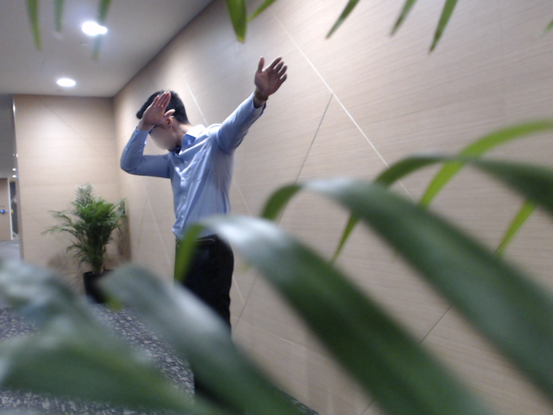
Mask R-CNN
It helps us to take away noise (background) and only focus on the person.
Easier classification
Ensures the model does not learn useless features
Notes:
It is outstanding because Mask R-CNN is used by many other self driving car companies.

Slide 2
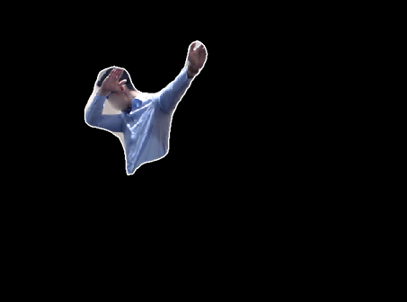
Masks we generated
The output of the Mask RCNN algorithm isolates the subject
Keeping only the largest two people to be classified
Mask R-CNN
Notes:
At first we only exported the largest detected person as we noticed that for some images there are irrelevant people in the background which will distract the classification process.
However, there is a limitation for this method as the handshake pose and chest bump pose involve two people. If we only keep the largest detected person, the handshake mask would be indistinguishable with the handgun mask and the chest bump mask would be similar with other one-person pose
Hence, we improved our method by keeping the two largest humans detected so as to ensure the accuracy of classification.

Slide 3
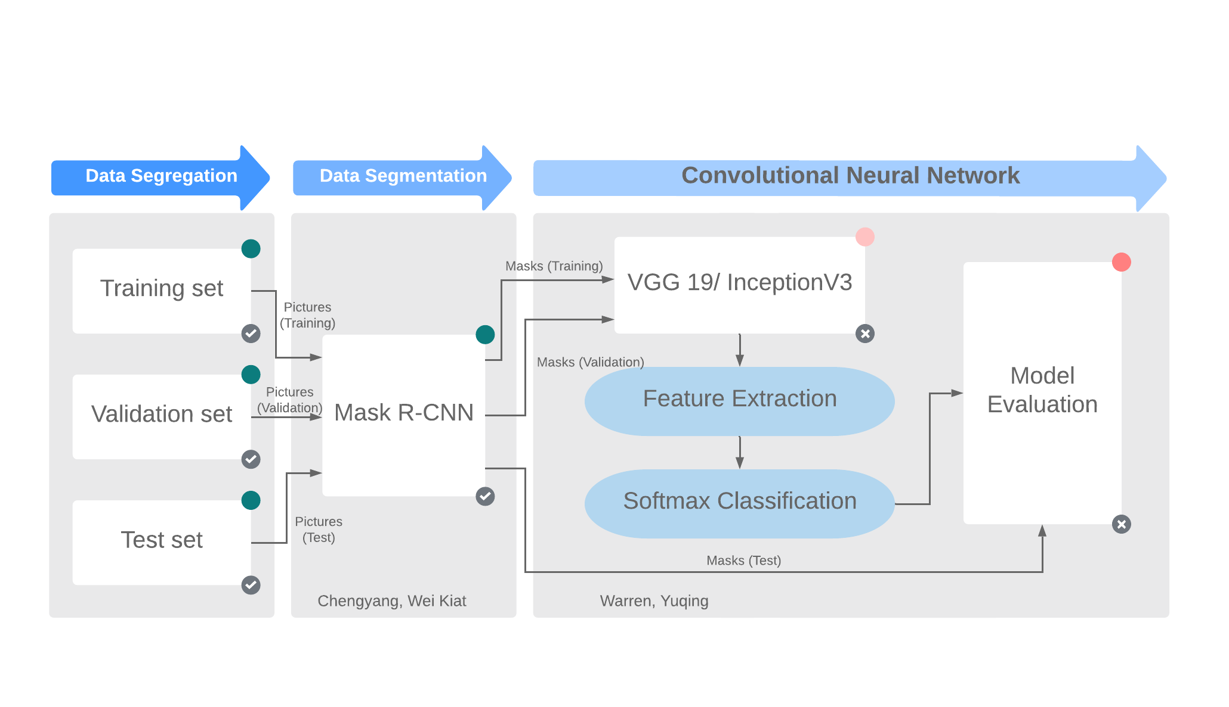
Pipeline
Pipeline chart designed by Yuqing

Slide 4
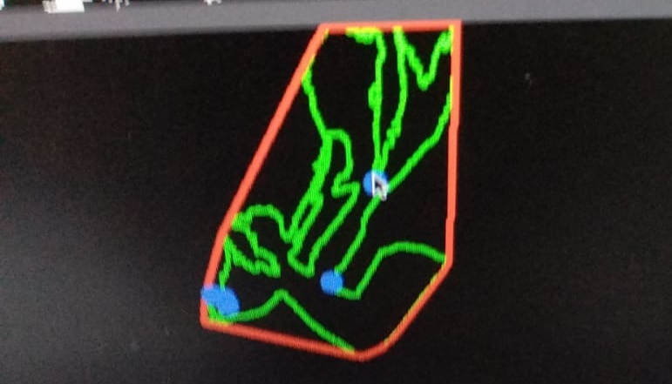
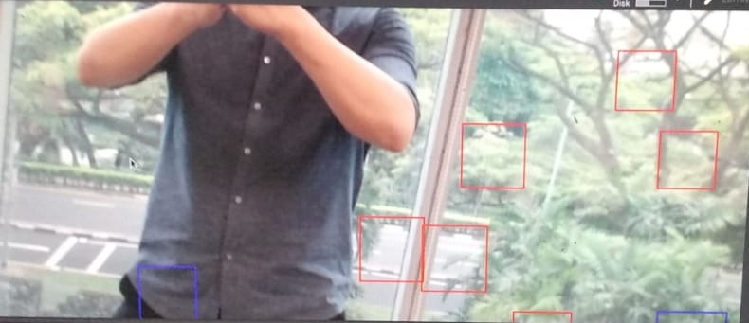
Things we have tried but didn’t work
Hand detection
Very inaccurate
Cannot correctly output the outline of hands
Detect some other objects as hands
Tested by Warren
Notes:
We notice that the hand pose is a significant feature that can help to distinguish classes involves mainly hand poses, for example, handgun and kung fu salute.
However, after we tried some hand detection libraries, we found that most of them are not very accurate as you can see from this graph.
Hence, we decided to discard hand detection and run all the classes through Mask R-CNN and then convolutional neural network

Slide 5
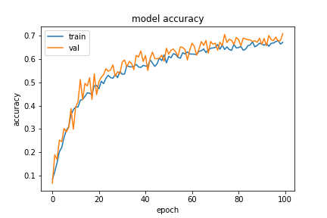
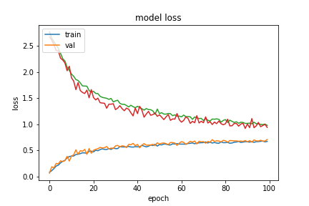
Results and Evaluations
Results:

